Slide 1

Deployment and Analysis of Z-wave IoT devices
Rishab Dhamija

Slide 2
What are IoT ?
Internet of Things (IoT) are physical devices connected to the internet.
Used for the purpose of collecting and sharing data without involvement
of a human being.
Can be connected to one or more sensors to provide them with an added level of
digital intelligence and to enable them to communicate real-time data.

Slide 3
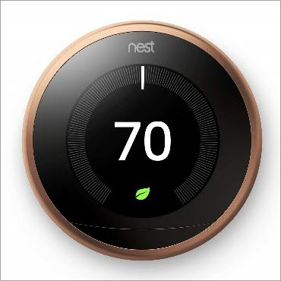

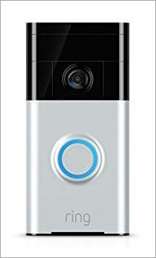

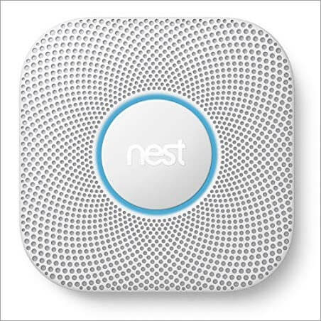
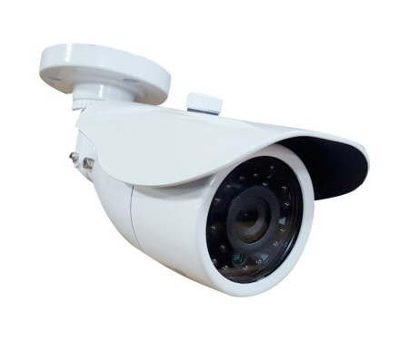
Examples

Slide 4
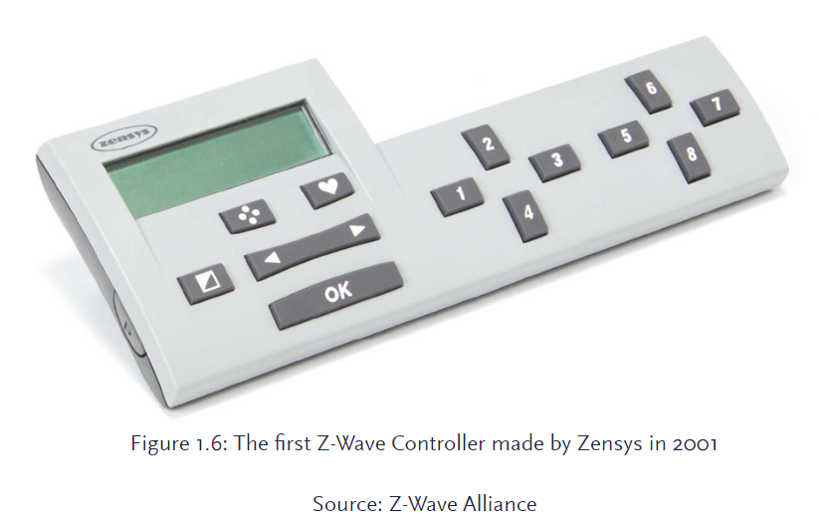
What is Z-Wave?
Developed by a Danish company named Zensys.
A low power, low bandwidth half-duplex two-way protocol.
Designed as a wireless communication technology for residential homes.
Advantages over other IoT networking technologies:
Operates at syb-1GHz frequency avoiding heavily congested 2.4 GHz and 5 GHz bands where Wi-Fi and ZigBee are positioned.
Ensures 100% interoperability→ all devices that implement Z-wave will work together in one single network and can be controlled from every controller that also uses Z-wave.
Offers Security of Communication as well as low radio emission.

Slide 5
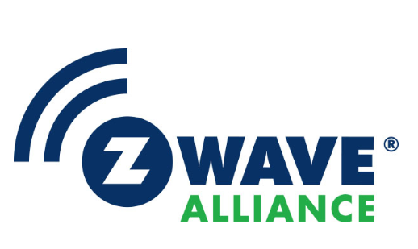
Z-Wave Alliance
Established in 2005.
Comprised of industry leaders across the globe that are dedicated to the development and extension of Z-Wave as the key enabling technology for “smart” home and businesses applications.
An alliance of 700 companies with over 3000 products, all interoperable with each other.
Assures the each Z-Wave product meets the standard for complete compliance with all other devices and controls.
Assures reliability to the consumers, dealers and manufacturers that these.

Slide 6

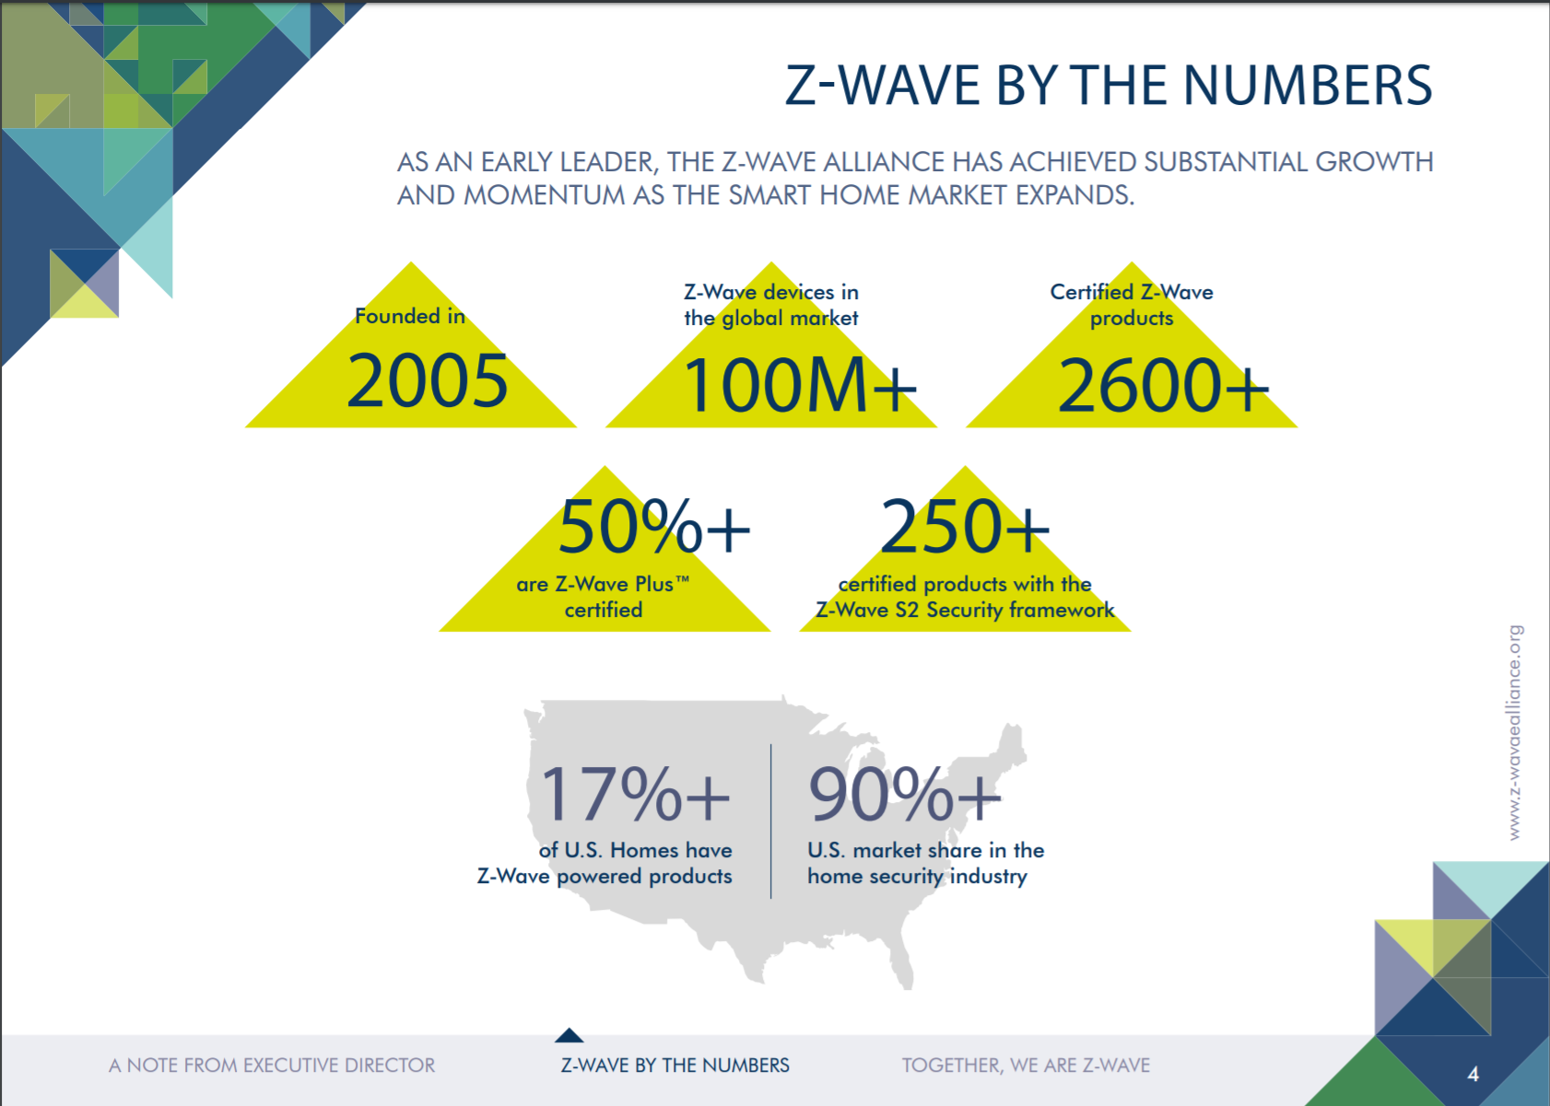
Z-Wave statistics 2018
Source : https://z-wavealliance.org/wp-content/uploads/2019/01/Z-Wave-Alliance-End-of-Year-Report-FINAL-for-web.pdf

Slide 7
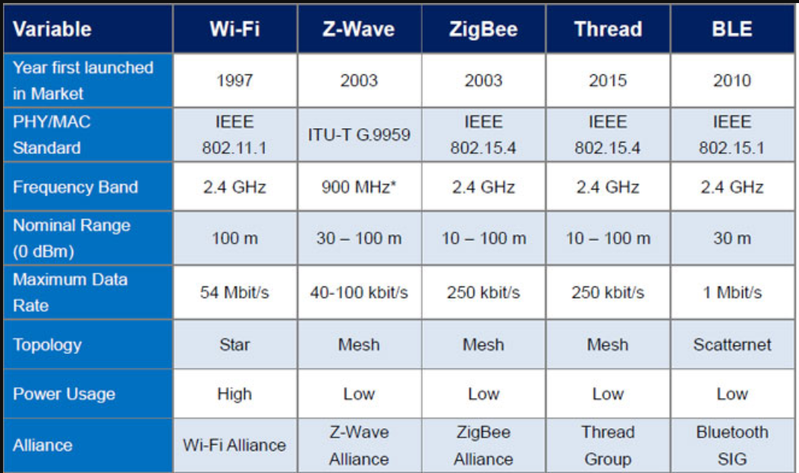
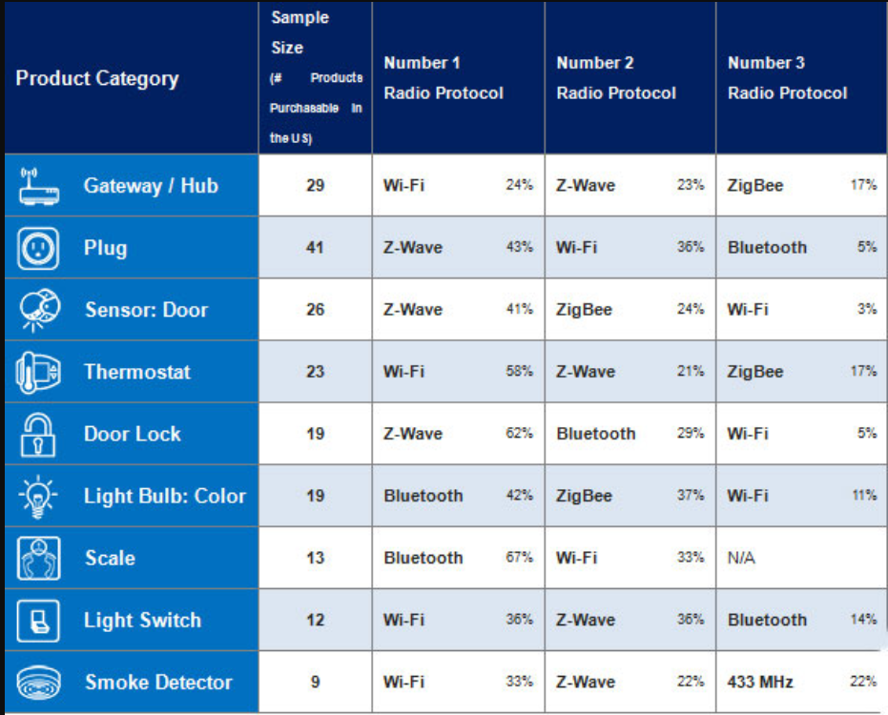
Z-waVE in REAL WORLD
Operates at 900 MHz ( a clear advantage over other wireless protocols as they all operate at the same Frequency band)
Plays a major contribution in terms of choice of Radio Protocol for most of the IoT devices as shown in the second image on the right.

Slide 8
Motivation
The sky rocketing growth of Z-Wave devices being used in the world
Very few research studies of the security of Z-Wave protocol based on real-world experimentation have been published.
The primary motive behind this research to bridge that gap between the two.

Slide 9
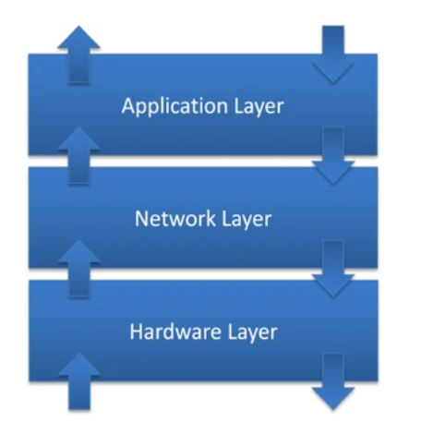
Z-Wave Protocol Layers
Z-Wave comprises of three major layers :
Radio Layer: defines the way a signal is exchanged between network as well as physical radio hardware. Includes frequency, encoding, hardware access etc.
Network Layer: defines how the data is exchanged between two devices or nodes. This layer’s functionality is further divided into 3 sublayers:
Media Access Layer (MAC)
Transport Layer
Routing Layer
Application Layer: defines which messages are to be handled by which specific applications to accomplish tasks such as switching a light on/off or changing the temperature of thermostat.

Slide 10

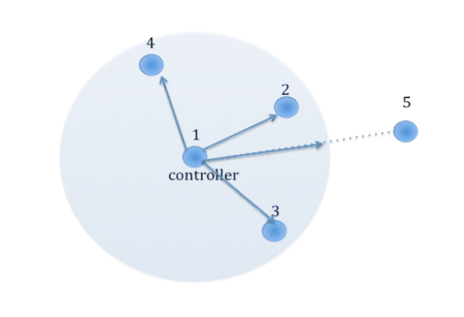
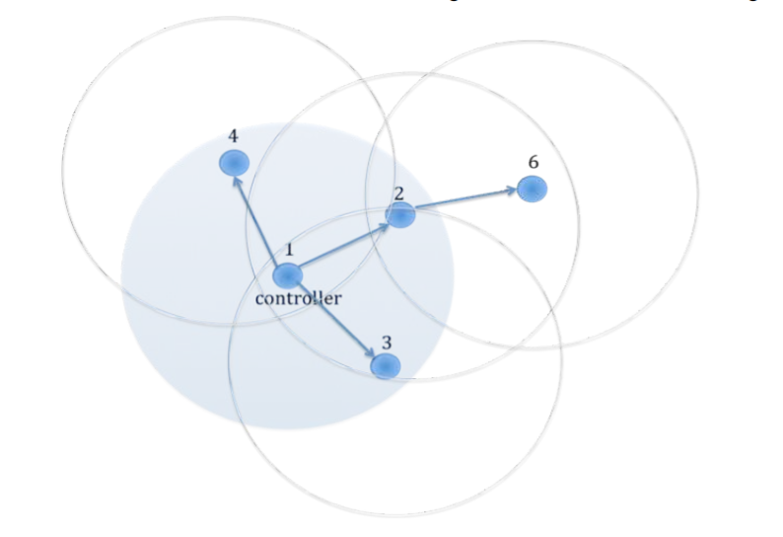
Meshing and Routing
Network without Routing
Node labelled 1 is the controller in the network.
Only nodes 2, 3 and 4 lie within the radio ranges of the controller. Therefore, only these can be reached directly by the controller.
Node 5 , outside the radio range , cannot be reached by the controller.
Z-Wave network with routing
Z-wave offers a powerful mechanism to overcome the problem highlighted above.
Z-Wave nodes can forward and repeat messages that are not in the direct range of the controller.
Node 1 is controller. It can communicate directly with nodes 2,3 and 4.
For node 6 being outside the radio range of controller, node 1 can communicate to 6 via node 2.
A possible route = Node 1 → Node 2 → Node 6

Slide 11

S0 Security Protocol
Involves Encryption + Message Authentication Code (MAC)
Message Integrity: assures receiver that message sent is by a secure node in the network and is unaltered.
Data Freshness: resembles that message has been sent recently (using Nonce).
Confidentiality: only secure nodes in the network can read the actual contents of the message.
Flaw : the shared network key is exchanged using 16-byte temporary key of all 0, which is publicly known.
Insecure against : DoS attack , hardware side-channel attack, traffic analysis, protocol side-channel and application-layer security attacks.

Slide 12
S2 Security Protocol
Uses the Diffie-Hellman Key Exchange process for exchanging the Network Key.
Elliptic Curve Diffie-Hellman (ECDH) → Provides the capability of shared secret between the two devices and addresses sender integrity.
Helps device manufacturers to focus more on the functionality rather than on the security of the device.
Involves Device Specific Key (DSK) , a unique key for every secure device.
Unique 40 digits for each device (Printed on the device)
Also comes in QR code for easy reference
This allows for validation of device identity.
Prevents man-in-the-middle attack

Slide 13
Main Objectives
Create a real-world Z-wave IoT network comprising of 2 devices (Trisensor as well as door/window sensor) and a controller.
Build a framework for Z-Wave traffic/packet monitoring and analysis.
Observe the use of S0 and S2 security modes in real-world Z-Wave network and identify the potential vulnerabilities of the two modes.

Slide 14


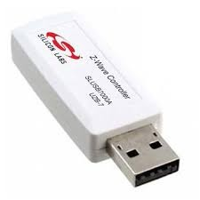
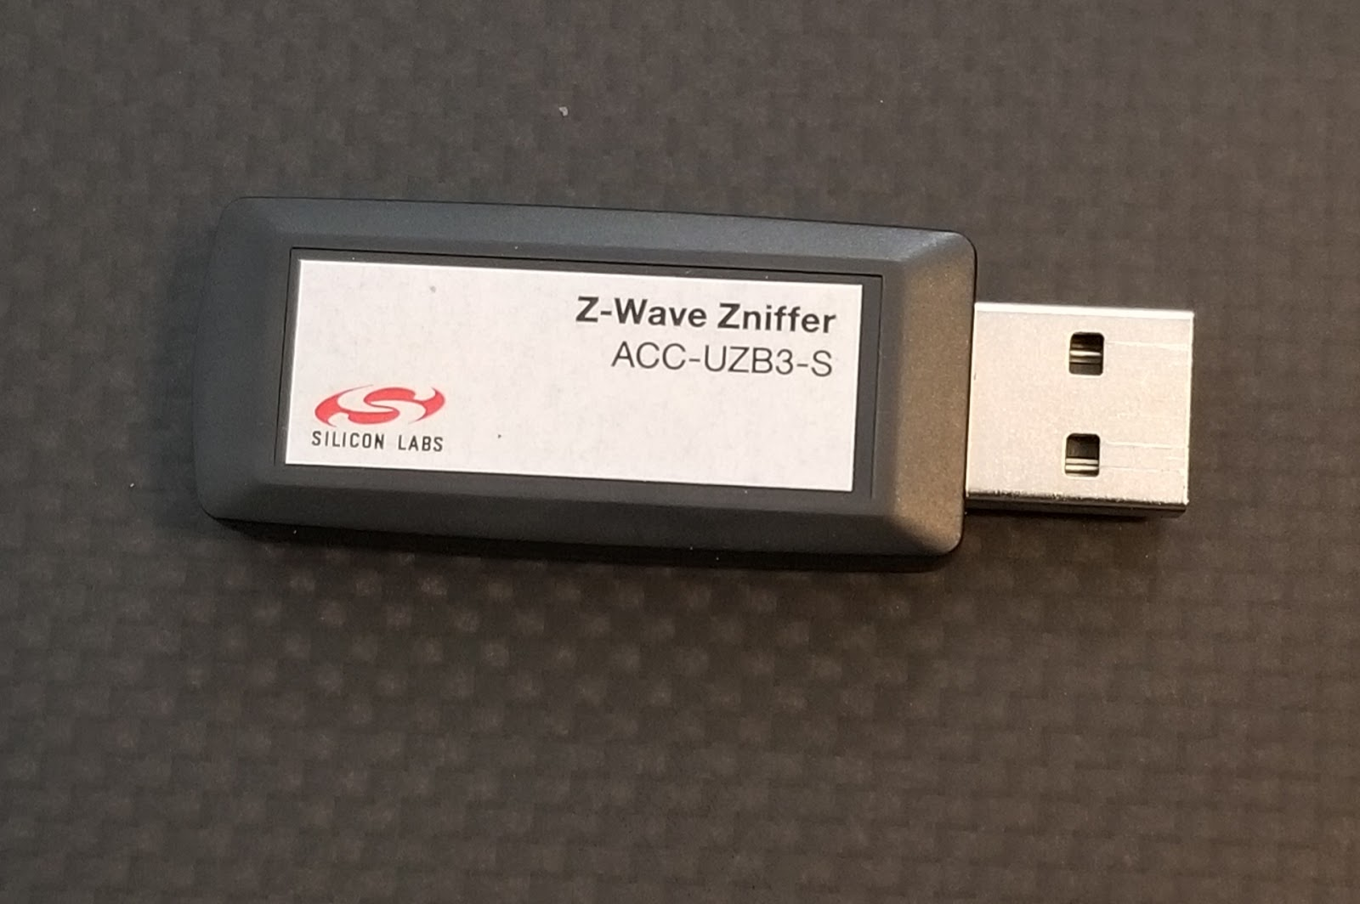
Experimental Framework
Deployed IoT devices:
1) Aeotec Trisensor (end-device #1)
2) Dome Door/Window Sensor (end-device #2)
3) Z-Wave Controller UZB-7
4) Z-Wave Zniffer UZB3-S
Software:
Z-Wave Zniffer
Z-wave PC Controller
Simplicity Studio (IDE)
Windows 10 (OS)

Slide 15
Challenges with Packet Sniffer
Primary choice of packet sniffer was Wireshark with added functionalities like dissector.
However, switching to Zniffer was result of several issues:
1)Wireshark does not support Z-wave primarily so using addons on top of it such as custom scripts and repositories wasn’t guaranteed success, which in our case was a failure.
2) there was no specific resource or guide as how to make Wireshark as Zniffer as most of the results published on the web are just customization done by people as per their convenience. Those results are not standard and changed from one environment to another.

Slide 16
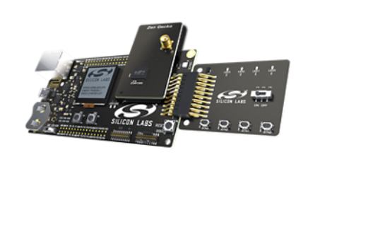
Challenges with Software/IDE
The initial steps of research focused on using Ubuntu with customized scripts and software such as GNU Radio and Audacity.
Second (and used) choice for Software and hardware was Silicon Labs with dedicated development Kits for developing and testing Z-wave networks.
Kit used for our research is : Z-Wave 700 Development kit
Pros of this approach:
Standardized among all Z-wave devices.
A reliable and resourceful platform for information regarding building network and testing it.
Cons of this approach:
The only way to learn for the dedicated software (Simplicity Studio, Z-Wave PC Controller as well as Z-Wave Zniffer ) and hardware was to read manuals for each of them and correlating them.
No support exists for asking questions outside their community forum.
Every documentation, tutorial or resource is strictly tied to their website. So this is the only source of research.

Slide 17
S0 Protocol
AFTER NETWORK KEY IS SHARED
trisensor → Nonce Get command to controller.
Controller →Nonce Report command to trisensor.
trisensor generates it own 8-byte nonce, concatenates it with controller’s Nonce to form 16-byte IV
IV = Sender (A’s ) Nonce || Receiver (B’s) Nonce
Since, the network key is already exchanged , 2 new keys are derived from it as follows (This is done on both trisensor and controller):
AES-encryption key = AES-ECB(Nk, Password-e)
MAC-authentication key = AES-ECB(Nk, Password-m)
Where Password-c is 0x55 times 16 and Password-m is 0xAA times 16. These values are hardcoded in the Z-wave firmware.
Trisensor uses these 2 keys along with the IV computed to encrypt and MAC-authenticate the frame and sends it to controller.
Controller also uses these 2 keys along with IV to authenticate and then decrypt the frame.
DURING NETWORK KEY SHARING
The controller generates the Network Key and wishes to share it with the trisensor for future messages.
Controller → Nonce Get command to trisensor.
trisensor → Nonce Report command to controller.
Controller generates it own nonce, concatenates it with trisensor’s Nonce to form 16-byte IV
IV = Sender (A’s ) Nonce || Receiver (B’s) Nonce
Controller uses the temporary key 0x00 times 16 along with IV to encrypt and MAC the Network key Nk . It sends it to trisensor.
Trisensor decrypts it using the temporary key, and gets the main Network key Nk.
THIS IS THE ONLY SECTION WHERE THE TEMPORARY KEY WAS USED.

Slide 18
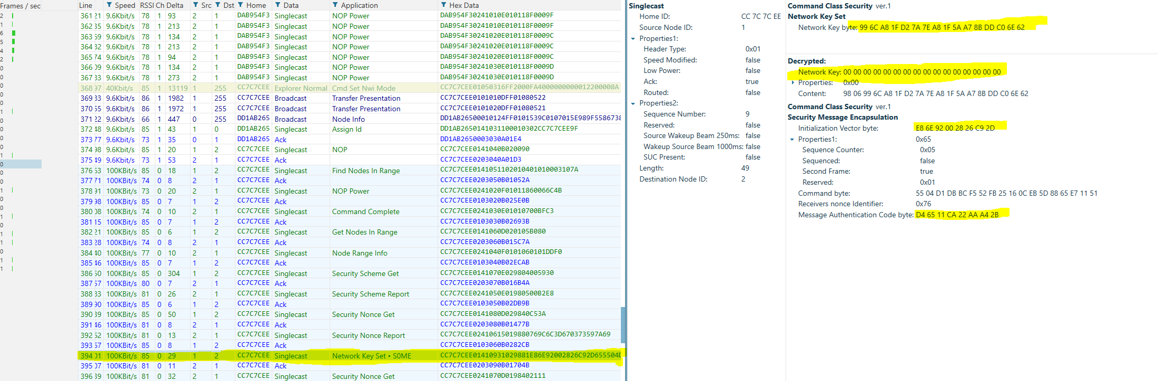
Obtained Results : S0
Based on the observed results above, the shared network key was exchanged using the temporary 16 byte all 0’s network key. Since, this key is known to everyone, it proved to be a major flaw as seen in the slides further.
Taking note from above, the network key obtained is 99 6C A8 1F D2 7A 7E A8 1F 5A A7 8B DD C0 6E 62.
Lets use this key to decrypt the future encapsulated messages between the controller and the trisensor.

Slide 19
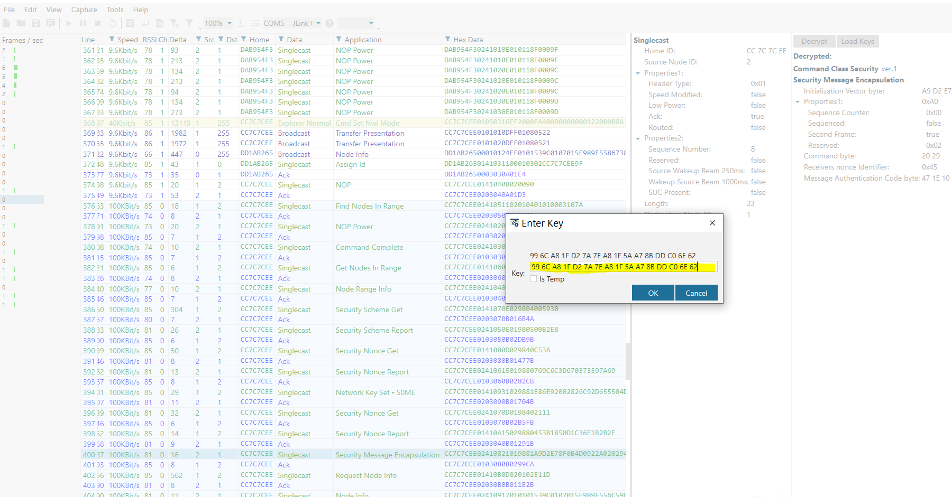
Obtained Results : S0
Here, we use the key obtained from the previous step to decrypt traffic between controller and the Trisensor.
Entering the key
99 6C A8 1F D2 7A 7E A8 1F 5A A7 8B DD C0 6E 62.

Slide 20
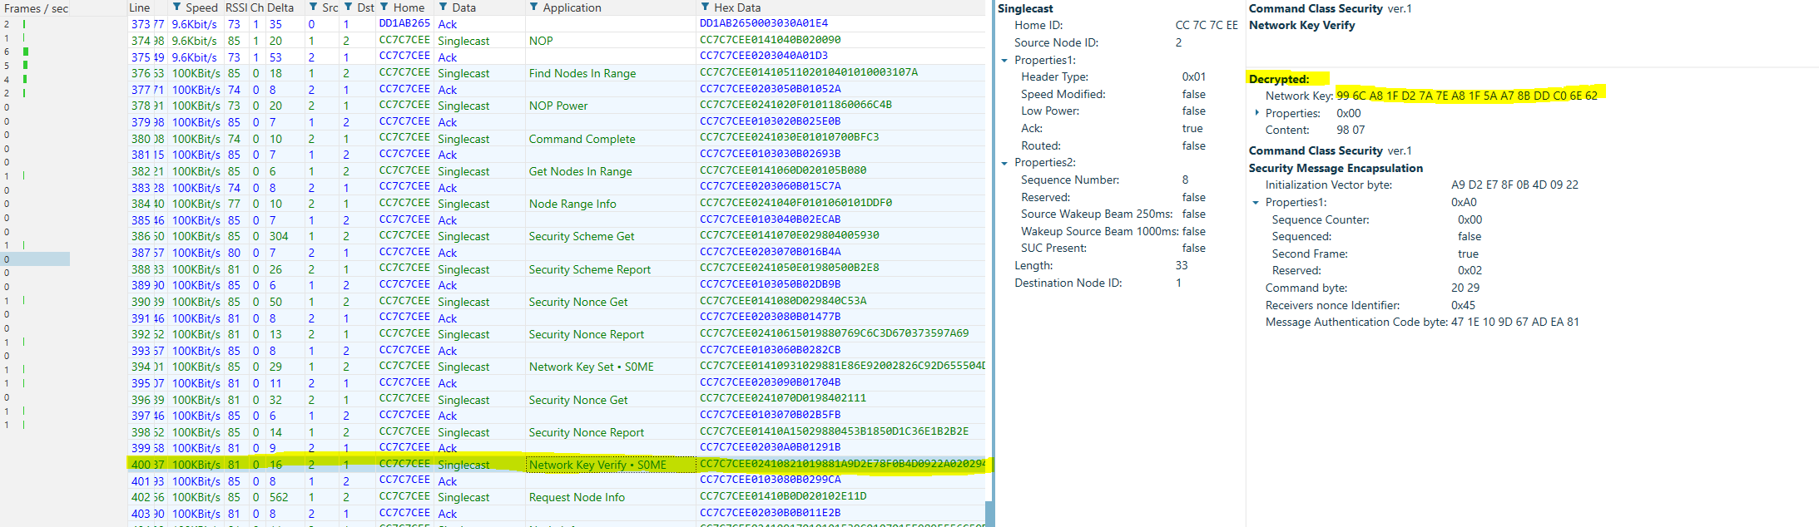
Obtained Results : S0
Success!! Using the key 99 6C A8 1F D2 7A 7E A8 1F 5A A7 8B DD C0 6E 62,
We were able to decrypt the traffic.

Slide 21
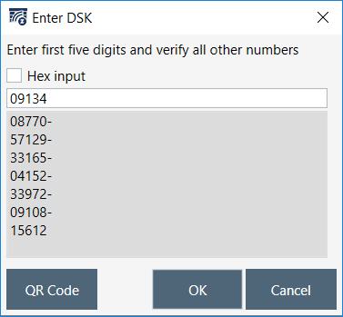
S2 Protocol: Out of Band Key Exchange for Product Authentication
Prevents eavesdropping and man -in-the-middle attack vectors.
Removes the possibility for a man-in-the-middle impersonation of the devices during the inclusion process.
Visual Scanning of the QR code / Entering the first 5 digits of the DSK in controller allows controller to validate that the device is real / not an impersonated one.
The first 5 digits of the DSK are replaced initially with 0s in the RF transmission. User is asked to enter them. This way, a user can confirm the identity of his device by comparing the remaining key with the one displayed.

Slide 22
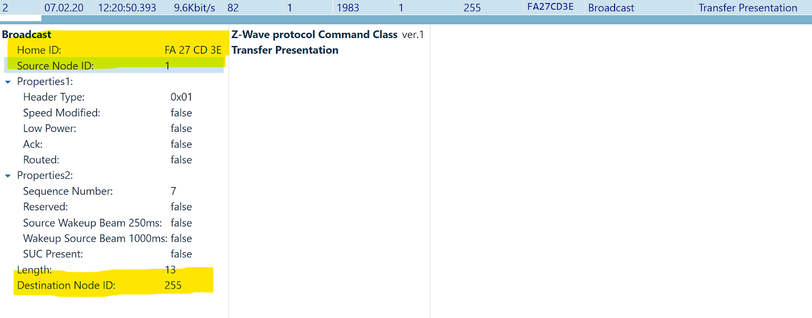
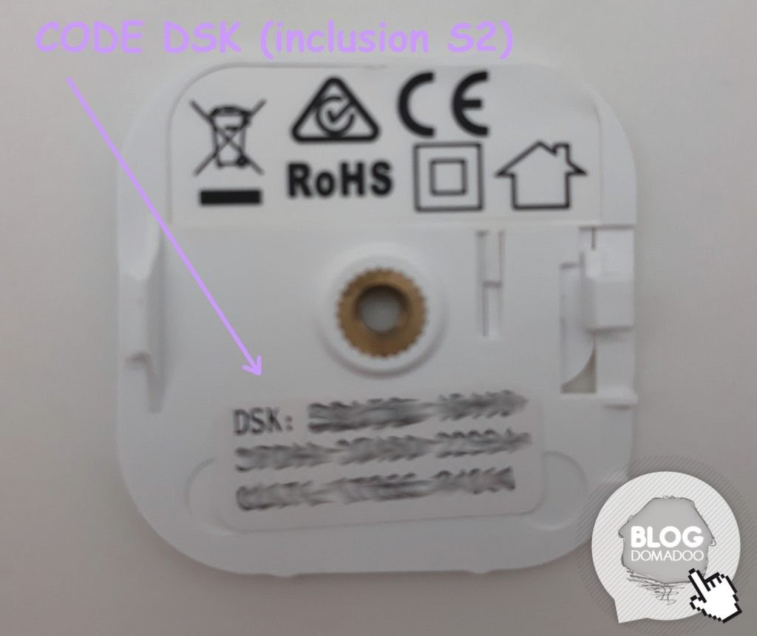
S2 Node Inclusion
Step 1: Press “Add Device” button on the controller (same as in case of S0)
Step 2: The very first frame is broadcasted by the Z-wave controller in the network to introduce itself.
Step 3: Press the “action button” on the sensor (Trisensor in this case)
Step 4: For S2 security devices (such as the trisensor we are using in the this experiment) , we either scan the DSK (Device Specific Key) QR code or input the underlined part of the DSK (which is shown on the label).

Slide 23
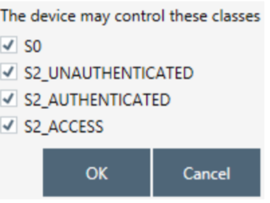
Step 5: When controller reads the signature of the trisensor,
it gets the following popup below:
<--- Note: This is the vulnerable step as attacker can uncheck the S2
boxes and make device connect in S0 (Z-Shave attack)

Slide 24
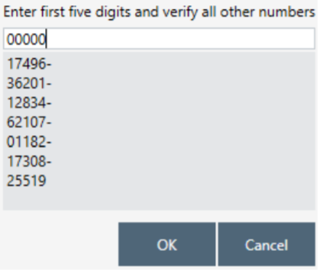
The popup shows the DSK request by the controller specific to the end-device which wants to join the network. In our case, we enter the first 5 digits of the DSK in the box on the left.

Slide 25
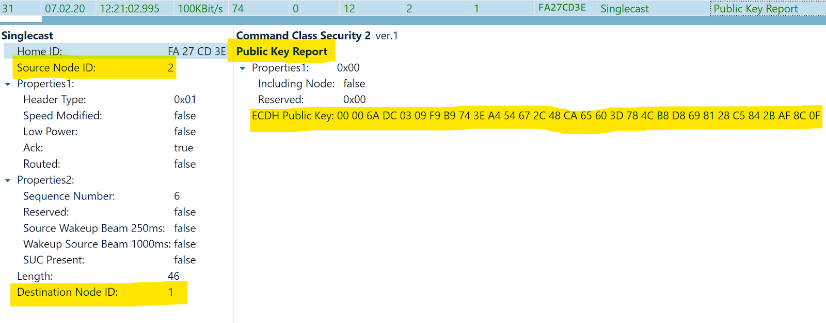
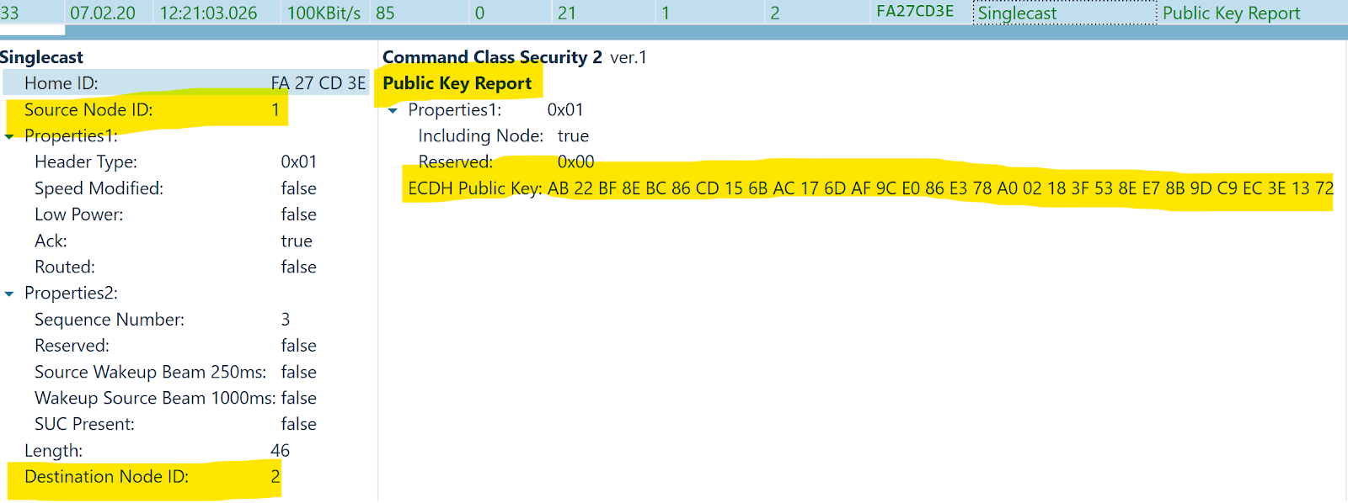
S2 Key Exchange using Diffie-Hellman
The actual Network Key is exchanged between the Controller and the sensor with the help of Diffie Hellman Key Exchange Algorithm
First, Trisensor sends his public ECDH key to the controller.
Next, the controller sends his ECDH public key to the sensor.

Slide 26
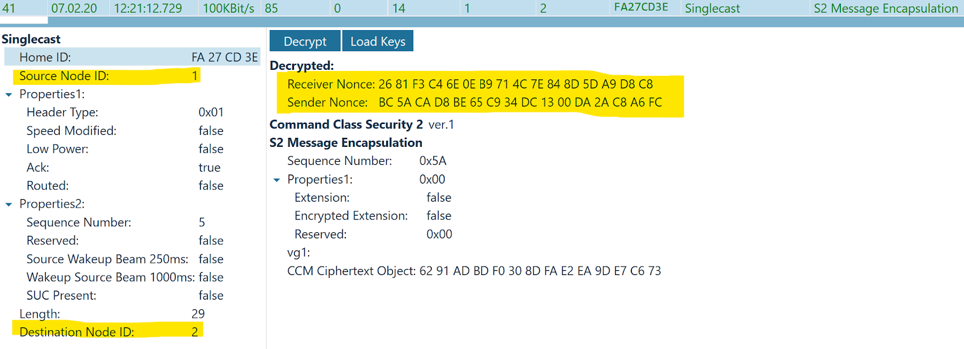
Obtained Results: S2
Decrypting the traffic using S2 is not possible since the network key is exchanged using Diffie-Hellman, contrary to the unsecure approach used in S0.
Moreover, S2 kept all of the features of S0 in addition to its Out of Band Key Exchange and DH , making it even more secure.

Slide 27

Future Work
Additional attacks that can be tested in the developed framework include:
DoS and DDoS attacks: can be can be actively performed on the trisensor.
Hijacking Attack : Spoofing a controller, especially in case of unsecure devices in highly favourable. An attacker can capture traffic of some other node in the network and get useful information such as Node ID of the controller as well as the Home ID of the network. The attacker can intervene by capturing the frame form controller to the slave, change the source Node ID from 1 (the original primary controller’s ID ) to his own (for example 2) and send the packet. The attacker can now wait and listen for any incoming packets on his Node ID.
Z-Shave Attack : this attack behaves like man-in-the-middle attack by downgrading the security protocols supported response from the IoT device to the controller. Downgrading the protocol from S2 to S0 makes it vulnerable to the flaw we covered in the results of S0. This attack is of high concern in the market as it puts millions of IoT devices at risk.

Slide 28



Thank You

